Slide 1
Agriculture Services

Slide 2
Project Presented by-
Shivani Subodh Chikhale.
Pragati Santosh Jadhav.
Sapana Bhaurao Ingale.
Batch:J-27
Project Guide: Miss Bharti Dewangan Mam.

Slide 3
introduction
Agriculture Services is built using JSP, Servlet, and MYSQL.
Agriculture Services System project in java is a web application where a user can search and view the Information using this system.
Users can search the Information of their choice according to the requirement online so it will be easy for users.

Slide 4
The main objective of this project is building a website which will help farmers from Indian villages too sell their products to different cities. Here if suppose some village farmers want to use this facility and want to learn how is it possible and how they can use e-farming to sell their products, if they have knowledge of computer then they can directly register in the site and sell their product otherwise they can contact company’s computer professional who will schedule classes to teach them basics of computers and internet like how they can open this site and register with it and sell their products online etc.
The main objective of this project is building a website which will help farmers from Indian villages to sell their products in different cities to different customers.
This Project is performing all the crud operations like EDIT/UPDATE/DELETE functions.

Slide 5
Scope of System
This system provides security.
Helps to maintain records.
Add and Manipulate Crop, Insecticides, Pesticides, Equipment details quickly & easily.
Maintain the database accurately.
Since the proposed system is computerized, so fast calculation is done.
It is time-saving since it maintains records accurately.
It does the manual task of the existing system automatically effectively and efficiently.
It provides a user-friendly GUI.
Through this system, it is possible to print various reports required for the organization.

Slide 6
System Requirements
1. Admin:-
Admin can Manage Information of Crops.
Admin can Manage Information of Insecticide.
Admin can Manage Information of Pesticide.
Admin can Manage Information of Equipment.
Admin can update its Password.
Admin can view its Profile.
Buy Customers Corps
Generates Reports: -
All Customers details
All Pesticides details
All Insecticide details
All Equipment details

Slide 7
2. Customer
• Customer can View/Search Information on Crops.
• Customer can View/Search Information about insecticides.
• Customer can View/Search Information on Pesticides.
• Customer can View/Search Information on Equipment.
• Customer can change their password.
• Customer can view their own Profiles.
• Customer can Sale their crops to specified Buyers.

Slide 8
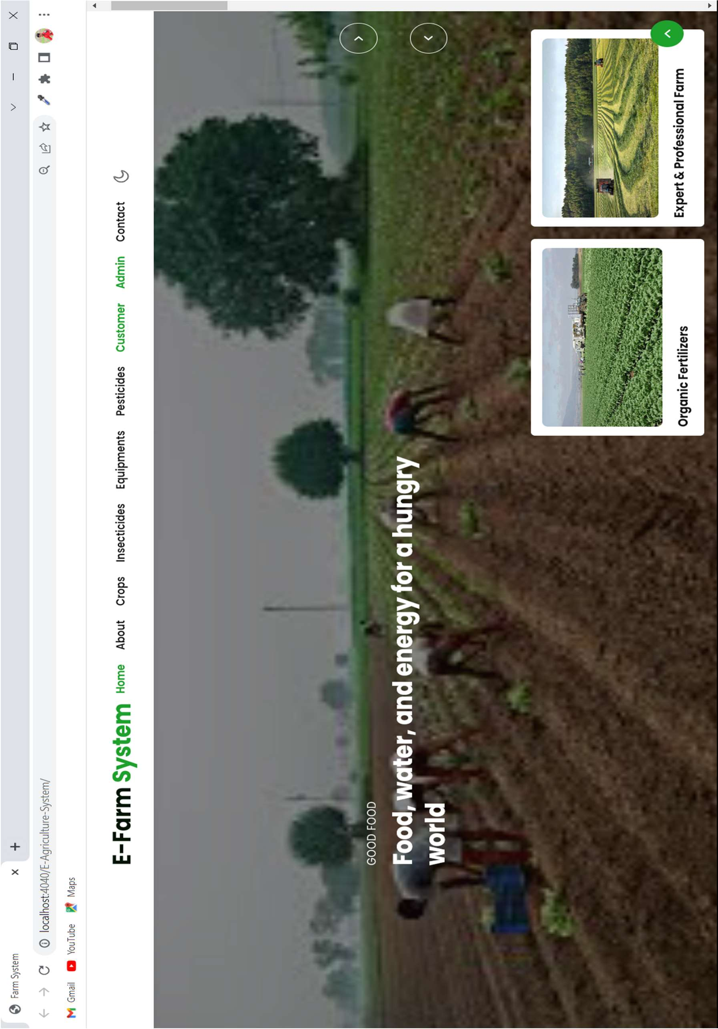
PAGE VIEW:

Slide 9
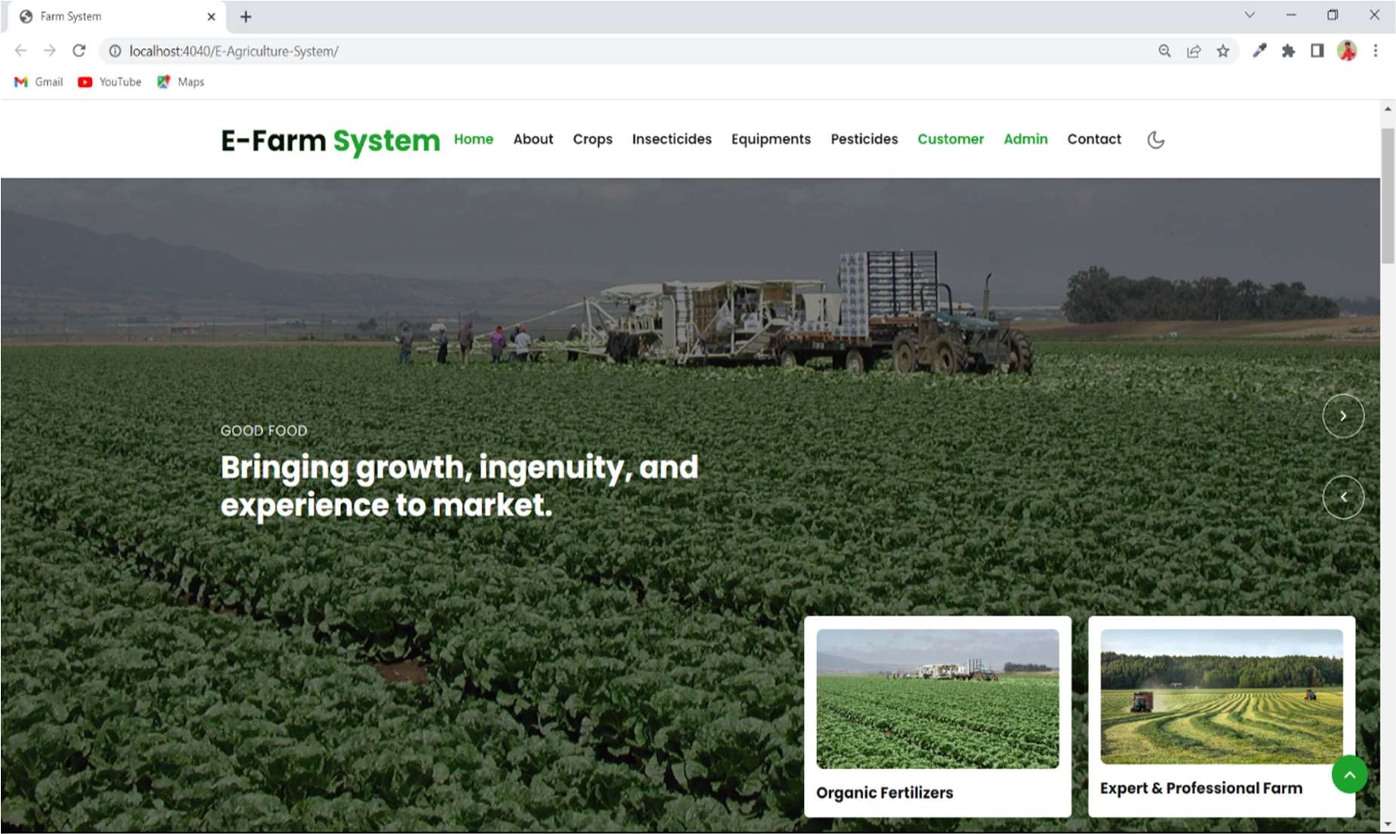
HOME:

Slide 10
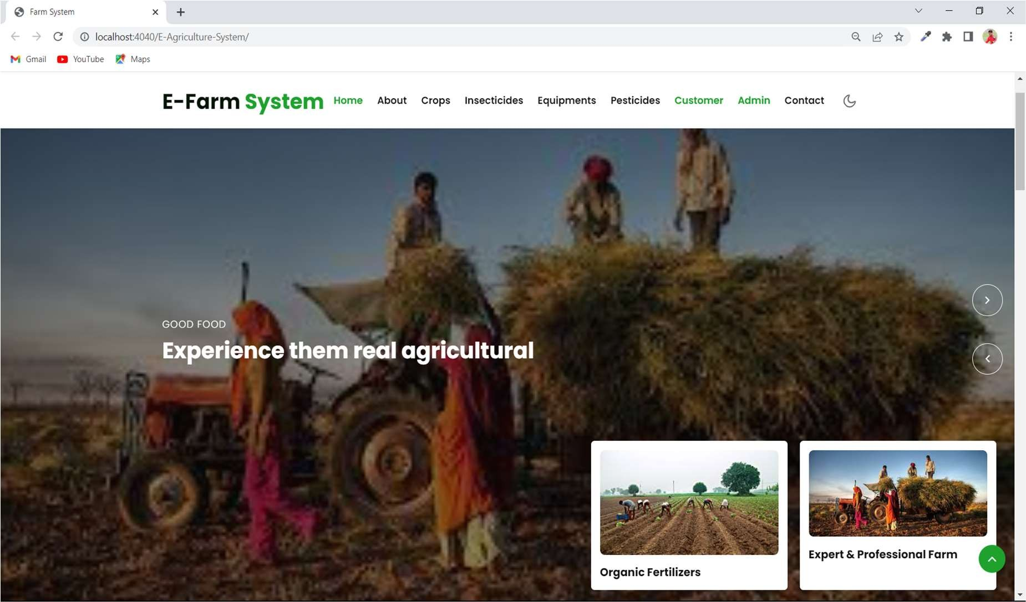
HOME:

Slide 11
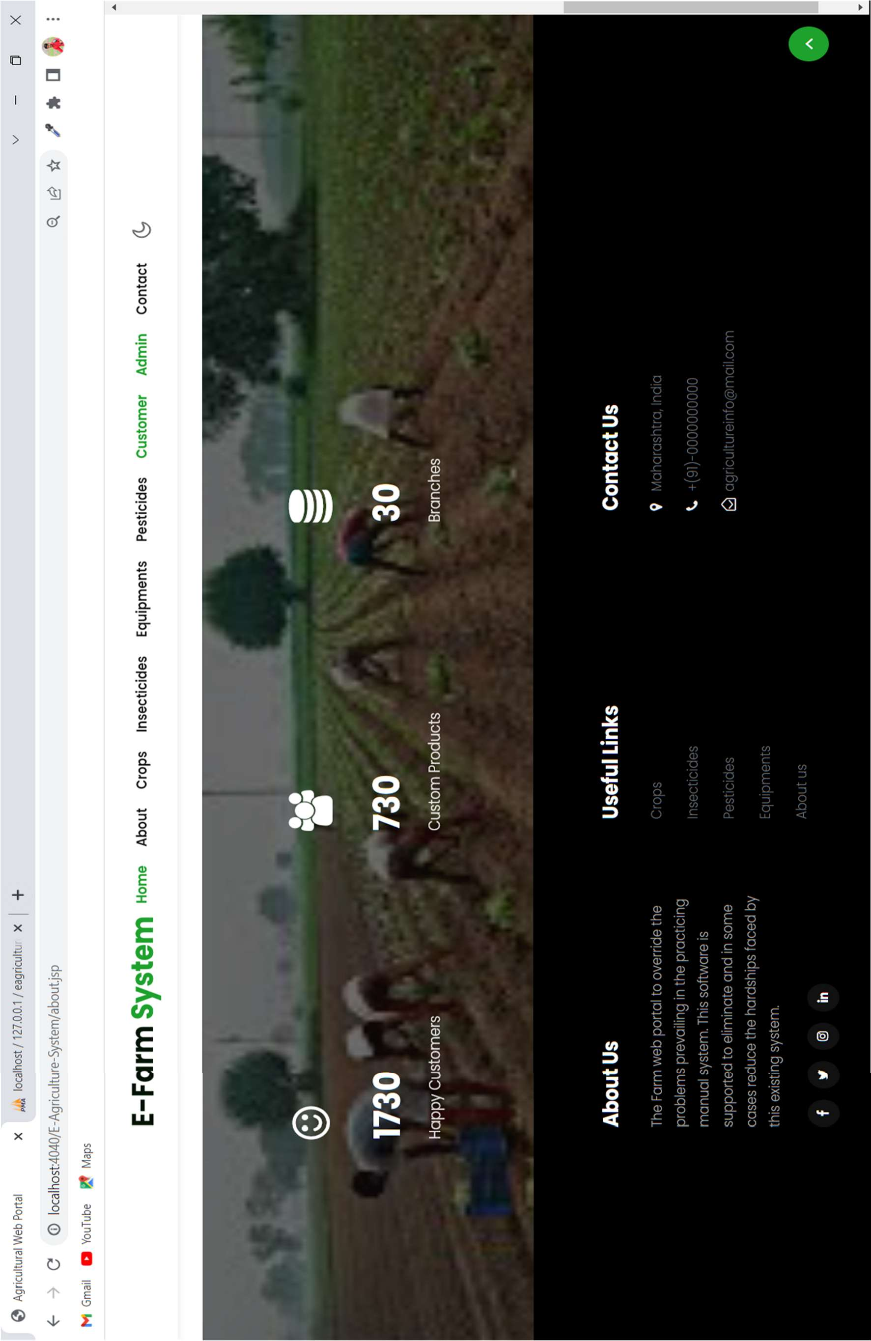
ABOUT:

Slide 12
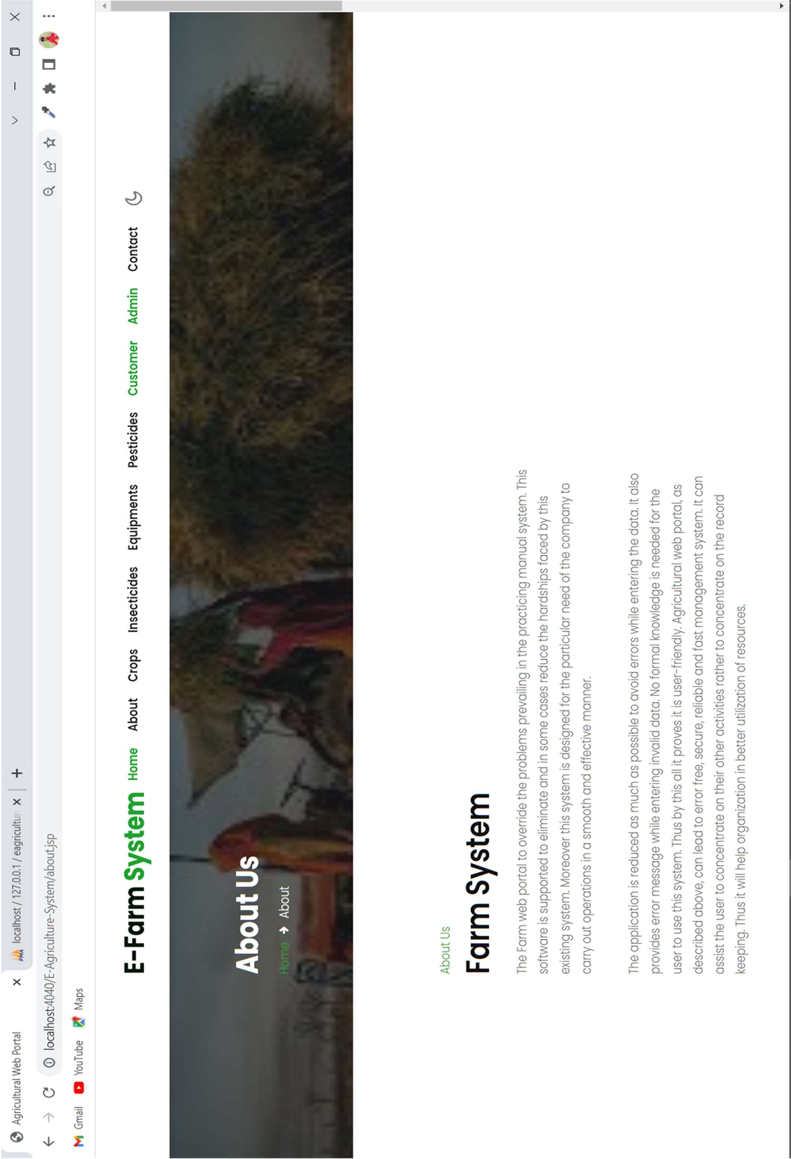
ABOUT US:

Slide 13
Thank you….

